Slide 1
SAP BTP Extension Suite Training
Day 4
Anubhav Oberoy
www.AnubhavTrainings.com
Follow excellence with sheer passion

Slide 2

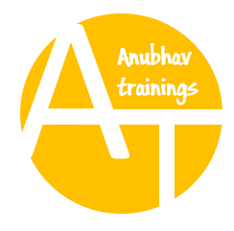
DISCLAIMER
The training content and delivery of this presentation is confidential, and cannot be recorded, or copied and distributed to any third party, without the written consent of Anubhav Trainings

Slide 3
Agenda – Day 4
01
Node Package Manager
02
Events, Async programming
03
First microservice using Node

Slide 4
























Slide 5
NPM – Node Package manager
It is a dependency manager tool which gets installed along with node js in our system. Just like for java we had maven, we have npm for node js.
We can find millions of reusable node modules free on internet, which helps us avoid rebuilding everything/reinvent the wheel.
We can see world’s largest reusable code repository on https://npmjs.com
If we want to install any node module
Globally - @computer level, all projects can reuse, option used to install CLI.
npm install -g module
With in the project - @localproject level, only single project can use
npm install module
When we build java project, we saw a pom.xml which contains dependencies. We have the package.json file in node project which contains details about our entire project and its dependencies. To create this we use npm init command.

Slide 6
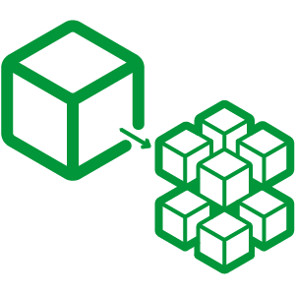

Hands on: Node JS
Solution:
https://github.com/soyuztechnologies/BTP_Architect_Training/blob/master/Day%203/02basicnode.zip
Node Microservice Solution:
https://github.com/soyuztechnologies/BTP_Architect_Training/blob/master/Day%203/03Nodemicroservice.zip

Slide 7
Functions in JS
Named Function
  Simple name
  Arrow function
Anonymous function

Slide 8


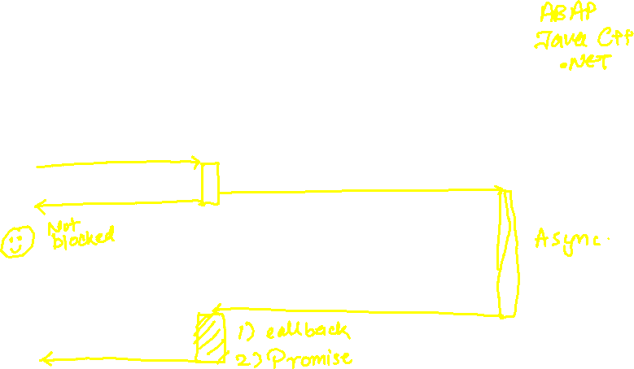


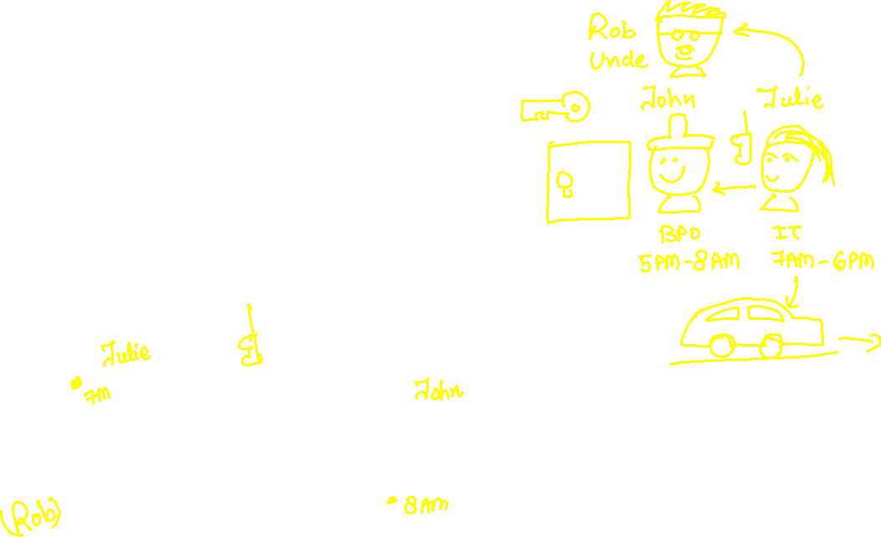

Asynchronous Non Blocking IO
Application
Server

Slide 9
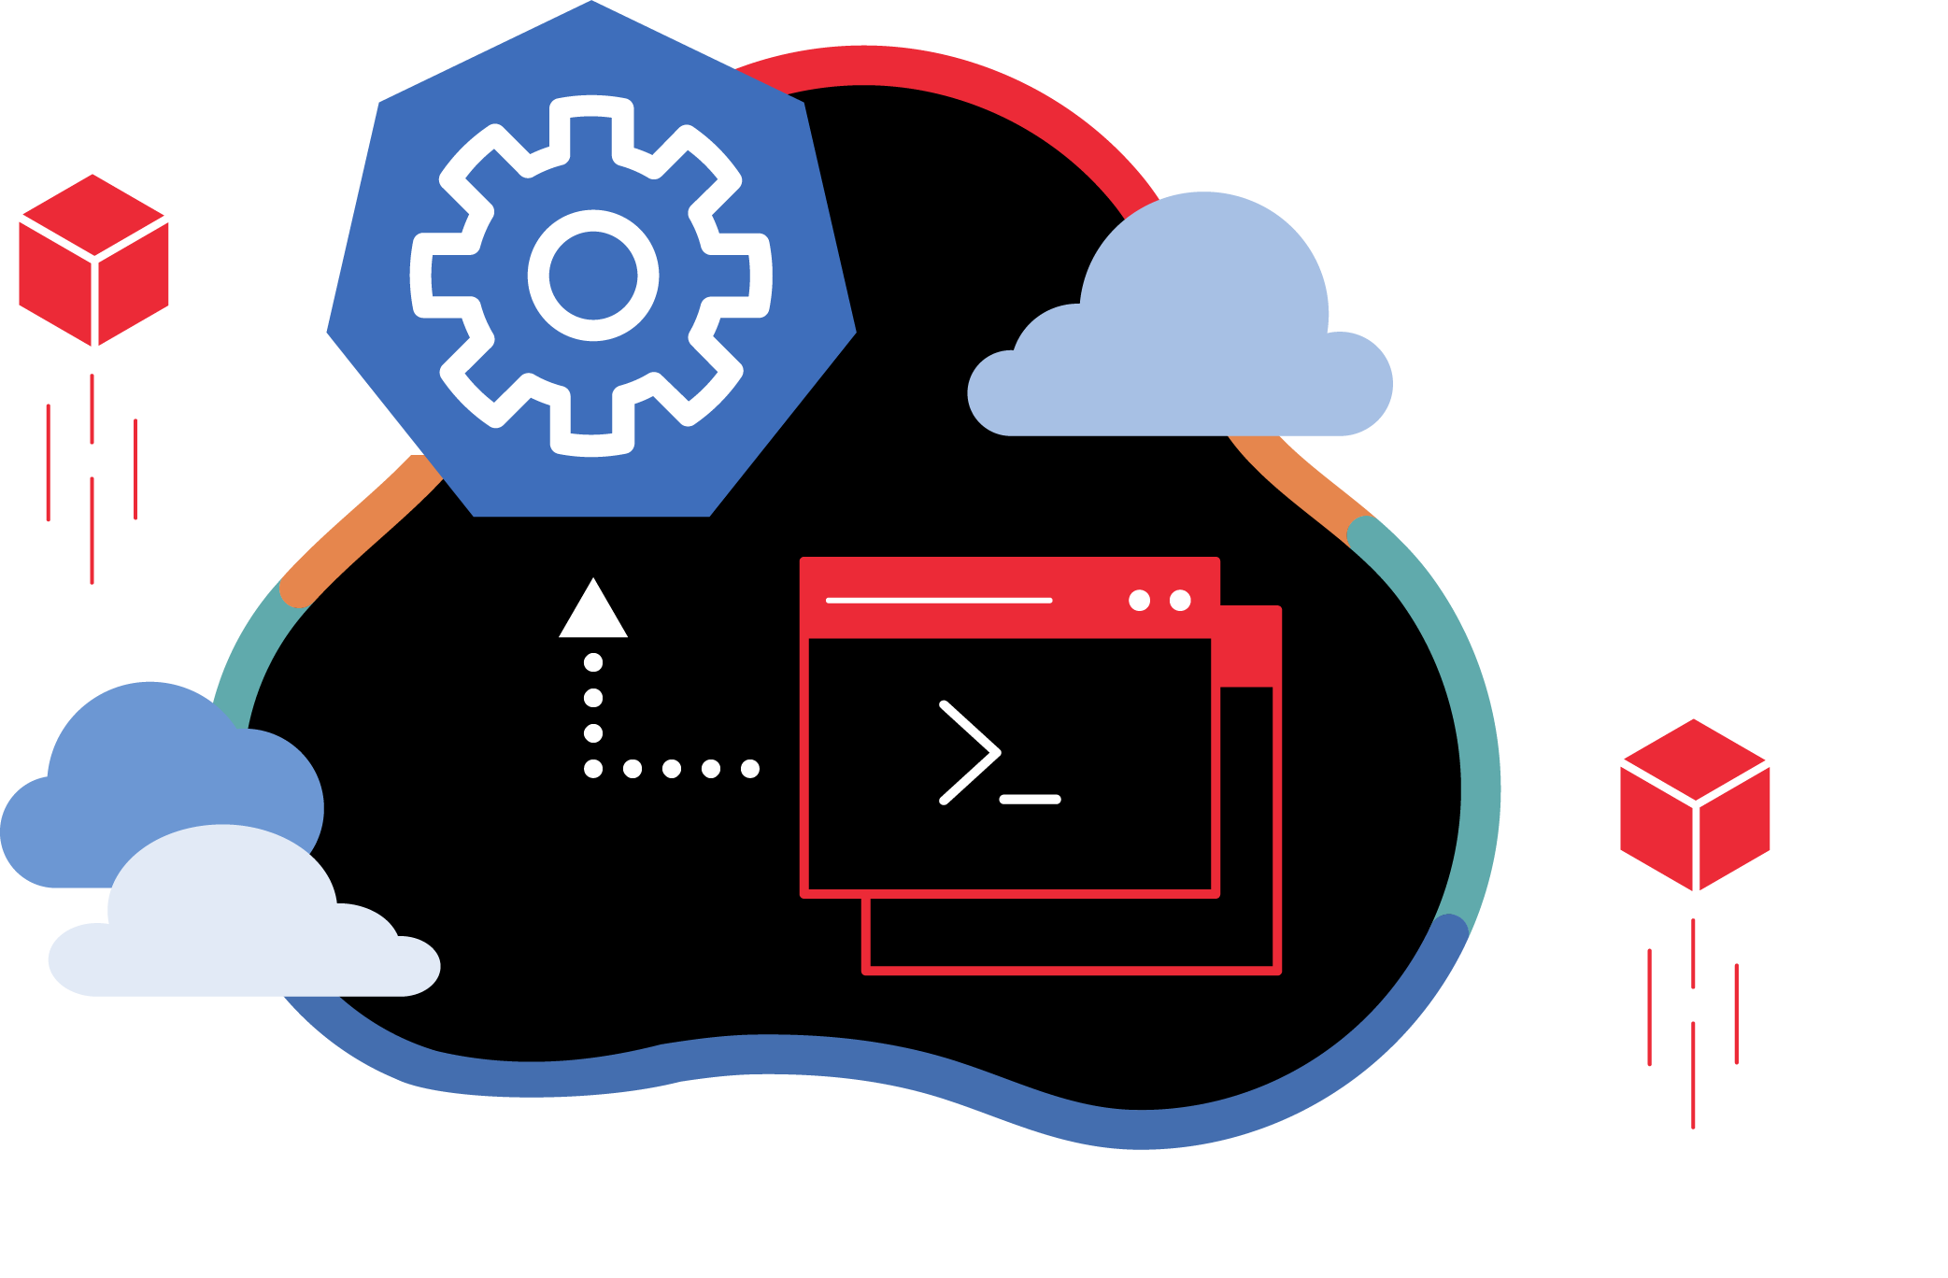
Deploy Node Microservice to BTP

Slide 10
Challenges of building Apps on BTP
What is the best-practice/ gold-standard to build sap btp applications, recommendation by SAP
Are there any existing sample apps which we can follow to build our app
Many times, as a developer it is hard to add each part of app like files, dependencies, deploy descriptor, lots of code. Can this process be simplified?
How can we have reusability of the code to speed up my development and use sap provided tools to generate the skeleton of the apps
As a developer we want to focus more on functional aspect implementation rather initial project setup
Our apps are sometime tightly coupled with DB technology, develop DB agnostic apps
No matter what is the area we belong FIN, SD, MM, PP, PM, APO, CRM, HR etc. eventually as a developer we all do same work. Design tables, write logic, build UI
How to develop software in BTP, which does not require too much time in handovers
SAP CAPM – Cloud Application Programming Model
It’s a SAP provided framework to develop SaaS apps in BTP which is PaaS. If the developer wants to use open source technologies like Node and Java. Great cost saving and freedom of choice of technology and consultants available easily in market.
SAP RAP – Restful Application Programming Model
It is based on ABAP on Cloud. We can build extensions and SaaS application using this framework. The skill required will be ABAP and CDS knowledge. The deployment is very costly as compared to open-source technologies used in CAP.

Slide 11
CAPM Introduction
CAPM is a framework of (a framework is a collection of libraries, classes, function, attributes, events)
Languages – Java and Node JS
Libraries – Node modules like cds, cds-dk etc.
And Tools – VS Code or BAS
The CAP framework is used for building enterprise grade applications & extensions which are cloud-native in SAP BTP.

Slide 12
CDS – Core Data and Services
Conceptually CDS is same concept but different flavor. The concept says that, we have a design time object which is a cds file. We will create a .cds file for almost everything e.g. database tables, views, models, services, UI/UX. This design time object file is compiled by CAPM framework (inside CAP we have node module called @sap/cds) Once the compilation is successful a runtime object gets created.
CREATE TABLE tab(c1 integer, c2 varchar(30), primary key (c1));
---2mn sql statements again
20bn dollars of investment
CREATE TABLE tab COLUMNS c1 integer, c2 varchar, KEY c1;
--20 lakh SQL statements
MySQL
HANA
Too much database coupled

Slide 13
Solution – use CAP framework
entity tab{
c1 number,
c2 string(20)
};
https://cap.cloud.sap/
Design time artefact
.cds
CAPM Framework
SQLite
@sap/cds
CDS Engine
HANA
SQL Code
Database Agnostic

Slide 14













Slide 15
Hands on: Modules for using CAP
We need to install sap cds-dk (Development kit), This kit includes required framework libraries and source code to build, test, deploy, run cap applications. It comes along with cds CLI which will be used by developers to quickly generate the cap project skeleton. This module needs to be installed globally in our system if we are using VS Code, in case we use BAS, this module is pre-installed.
npm install -g @sap/cds-dk
node version >= 14
Check if the CAP is installed in my system ➔ cds –v & cds --help
Create a folder in our computer, and run cds init command. This will create a project skeleton automatically which includes db, srv, ui folders.
If you want to quickly manage multiple node versions in your computer you can use nvm tool - https://github.com/coreybutler/nvm-windows/releases
When we make constant changes to the project, we want project to detect a correction and automatically restart the server. We can use the cds watch command instead of cds run

Slide 16

What We Did
Let’s Summarize

Slide 17

www.anubhavtrainings.com
Thank You
End of Day 2

Slide 18


We’re committed to empower you to be
#FutureReady
through powerful training solutions.
We build the workforce of the future.
250+
Corporate Clients
30,000+
Learners Trained
25000+
Learners Placed
FREE WEBINARS
Sign up for free webinars with industry experts every fortnight!
Enroll Now!
Contact us today!
https://anubhavtrainings.com

